Slide 1

BASIS DATA - TI14KB21
Meeting 5
Normalization
Bagus Kristomoyo Kristanto S.Kom , M.MT
bagus.kristanto@stiki.ac.id

Slide 2
Outline
01
How to undertake process of normalization
How to identify most commonly used normal forms, namely 1NF, 2NF, 3NF, and Boyce – Codd normal form (BCNF).
02

Slide 3
Normalization
Main objective in developing a logical data model for relational database systems is to create an accurate representation of the data, its relationships, and constraints.
To achieve this objective, must identify a suitable set of relations.
Four most commonly used normal forms are first (1NF), second (2NF) and third (3NF) normal forms, and Boyce–Codd normal form (BCNF).
Based on functional dependencies among the attributes of a relation.
A relation can be normalized to a specific form to prevent possible occurrence of update anomalies.

Slide 4
Normalization
Main objective in developing a logical data model for relational database systems is to create an accurate representation of the data, its relationships, and constraints.
To achieve this objective, must identify a suitable set of relations.
Four most commonly used normal forms are first (1NF), second (2NF) and third (3NF) normal forms, and Boyce–Codd normal form (BCNF).
Based on functional dependencies among the attributes of a relation.
A relation can be normalized to a specific form to prevent possible occurrence of update anomalies.

Slide 5
Data Redundancy
Major aim of relational database design is to group attributes into relations to minimize data redundancy and reduce file storage space required by base relations.
Problems associated with data redundancy are illustrated by comparing the following Staff and Branch relations with the StaffBranch relation.

Slide 6
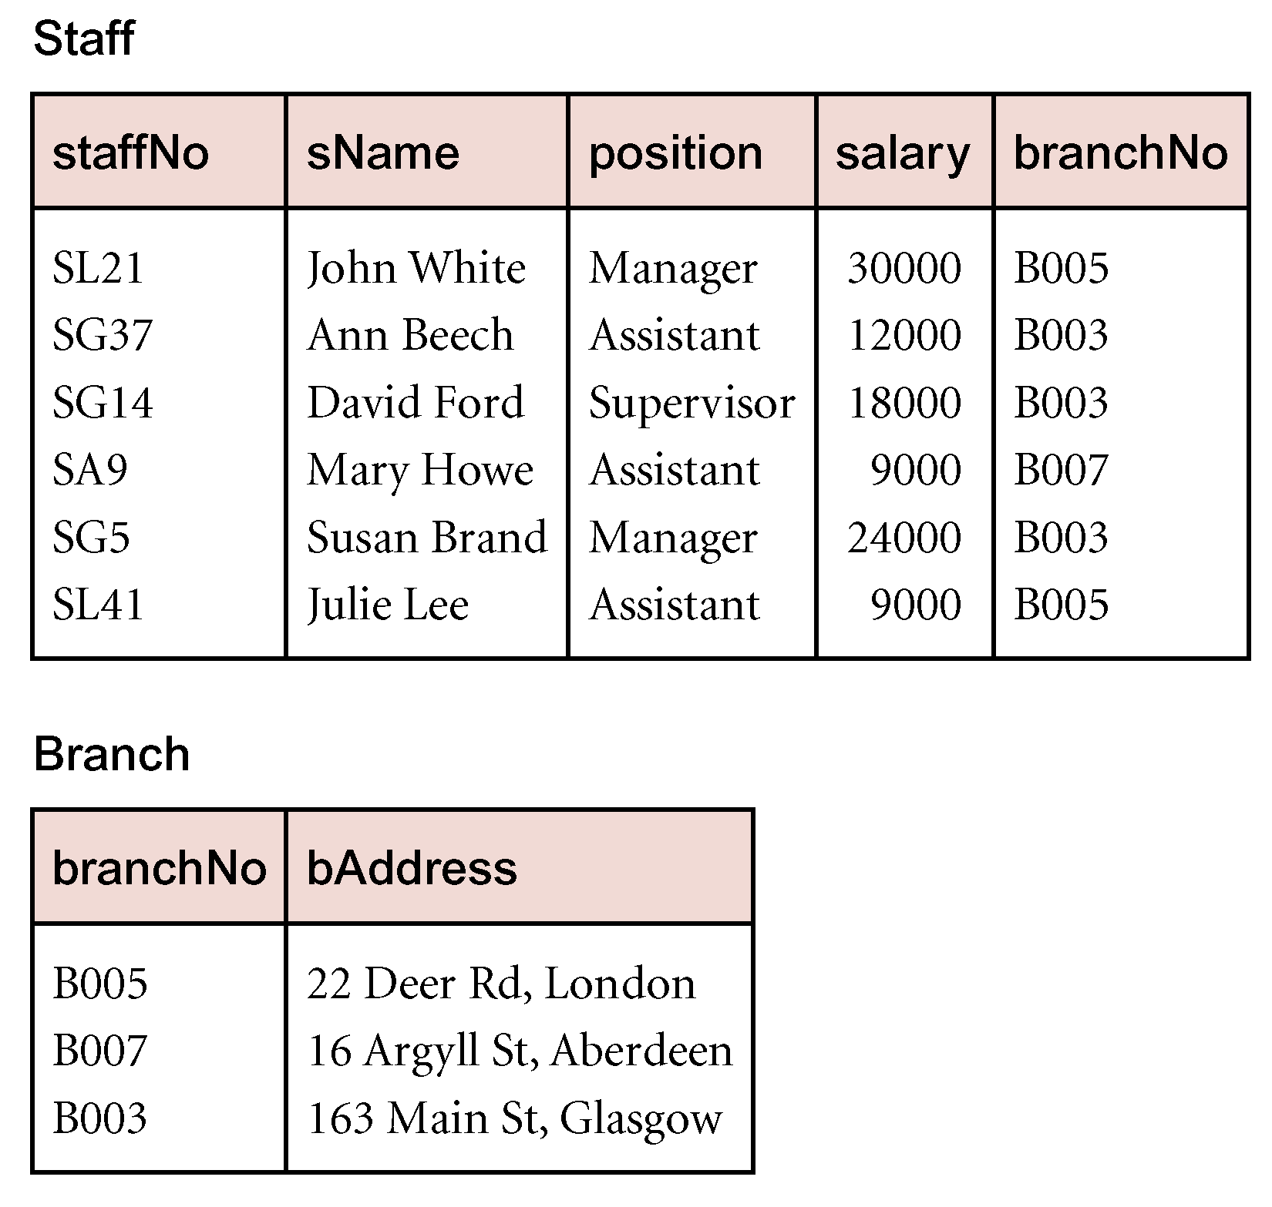
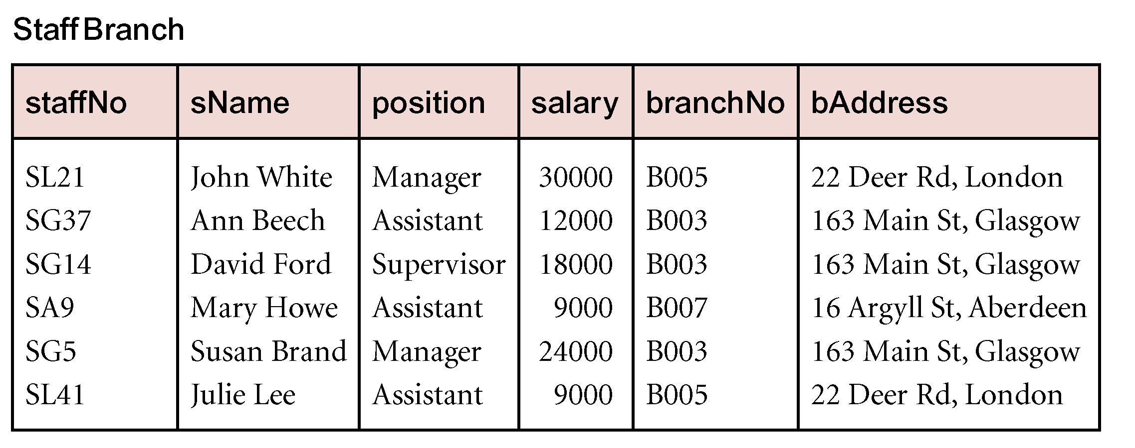
Data Redundancy

Slide 7
Data Redundancy
StaffBranch relation has redundant data: details of a branch are repeated for every member of staff.
In contrast, branch information appears only once for each branch in Branch relation and only branchNo is repeated in Staff relation, to represent where each member of staff works.

Slide 8
Update Anomalies
Relations that contain redundant information may potentially suffer from update anomalies.
Types of update anomalies include:
Insertion,
Deletion,
Modification.

Slide 9
Lossless-join and Dependency Preservation Properties
Two important properties of decomposition:
Lossless-join property enables us to find any instance of original relation from corresponding instances in the smaller relations.
Dependency preservation property enables us to enforce a constraint on original relation by enforcing some constraint on each of the smaller relations.

Slide 10
Functional Dependency
Main concept associated with normalization.
Functional Dependency
Describes relationship between attributes in a relation.
If A and B are attributes of relation R, B is functionally dependent on A (denoted A  B), if each value of A in R is associated with exactly one value of B in R.

Slide 11
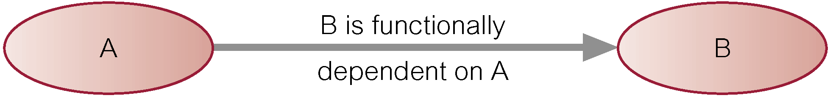
Functional Dependency
Property of the meaning (or semantics) of the attributes in a relation.
Diagrammatic representation:
Determinant of a functional dependency refers to attribute or group of attributes on left-hand side of the arrow.

Slide 12
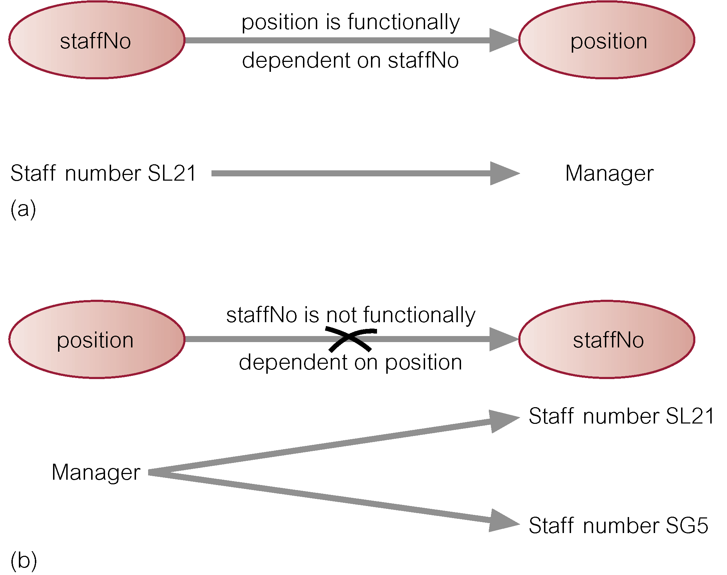
Example - Functional Dependency

Slide 13
Functional Dependency
Main characteristics of functional dependencies used in normalization:
have a 1:1 relationship between attribute(s) on left and right-hand side of a dependency;
hold for all time;
are nontrivial.
Complete set of functional dependencies for a given relation can be very large.
Important to find an approach that can reduce set to a manageable size.
Need to identify set of functional dependencies (X) for a relation that is smaller than complete set of functional dependencies (Y) for that relation and has property that every functional dependency in Y is implied by functional dependencies in X.

Slide 14
Functional Dependency
Set of all functional dependencies implied by a given set of functional dependencies X called closure of X (written X⁺).
Set of inference rules, called Armstrong’s axioms, specifies how new functional dependencies can be inferred from given ones.
Let A, B, and C be subsets of the attributes of relation R. Armstrong’s axioms are as follows:
1. Reflexivity
If B is a subset of A, then A → B
2. Augmentation
If A → B, then A,C → Β,C
3. Transitivity
If A → B and B → C, then A → C

Slide 15
The Process of Normalization
Formal technique for analyzing a relation based on its primary key and functional dependencies between its attributes.
Often executed as a series of steps. Each step corresponds to a specific normal form, which has known properties.
As normalization proceeds, relations become progressively more restricted (stronger) in format and also less vulnerable to update anomalies.

Slide 16
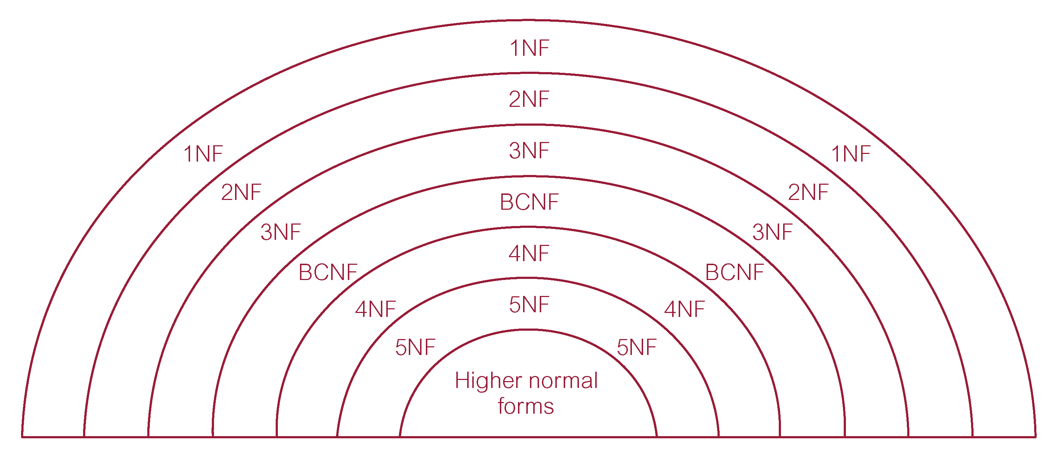
Relationship Between Normal Forms

Slide 17
Unnormalized Form (UNF)
A table that contains one or more repeating groups.
To create an unnormalized table:
transform data from information source (e.g. form) into table format with columns and rows.

Slide 18
First Normal Form (1NF)
A relation in which intersection of each row and column contains one and only one value.

Slide 19
UNF to 1NF
Nominate an attribute or group of attributes to act as the key for the unnormalized table.
Identify repeating group(s) in unnormalized table which repeats for the key attribute(s).
Remove repeating group by:
entering appropriate data into the empty columns of rows containing repeating data (‘flattening’ the table).
Or by
placing repeating data along with copy of the original key attribute(s) into a separate relation.

Slide 20
1NF to 2NF
Identify primary key for the 1NF relation.
Identify functional dependencies in the relation.
If partial dependencies exist on the primary key remove them by placing them in a new relation along with copy of their determinant.

Slide 21
Third Normal Form (3NF)
Based on concept of transitive dependency:
A, B and C are attributes of a relation such that if A  B and B  C,
then C is transitively dependent on A through B. (Provided that A is not functionally dependent on B or C).
3NF - A relation that is in 1NF and 2NF and in which no non-primary-key attribute is transitively dependent on the primary key.

Slide 22
2NF to 3NF
Identify the primary key in the 2NF relation.
Identify functional dependencies in the relation.
If transitive dependencies exist on the primary key remove them by placing them in a new relation along with copy of their determinant.

Slide 23
General Definitions of 2NF and 3NF
Second normal form (2NF)
A relation that is in 1NF and every non-primary-key attribute is fully functionally dependent on any candidate key.
Third normal form (3NF)
A relation that is in 1NF and 2NF and in which no non-primary-key attribute is transitively dependent on any candidate key.

Slide 24
Source
https://www.studytonight.com/dbms/database-normalization.php
https://www.guru99.com/database-normalization.html

Slide 25
Thank you

